Slide 1

IBM SkillsBuild Internship
Name : Khaviya R T
Mail ID : khaviyathalapathi@gmail.com
College Name : B S Abdur Rahman Crescent Institute of Science and Technology
College State : Tamil Nadu
Domain : Front-End Development
Duration : 24th June 2024 - 31st July 2024

Slide 2

PROJECT TOPIC
NETFLIX CLONE WEBSITE

Slide 3
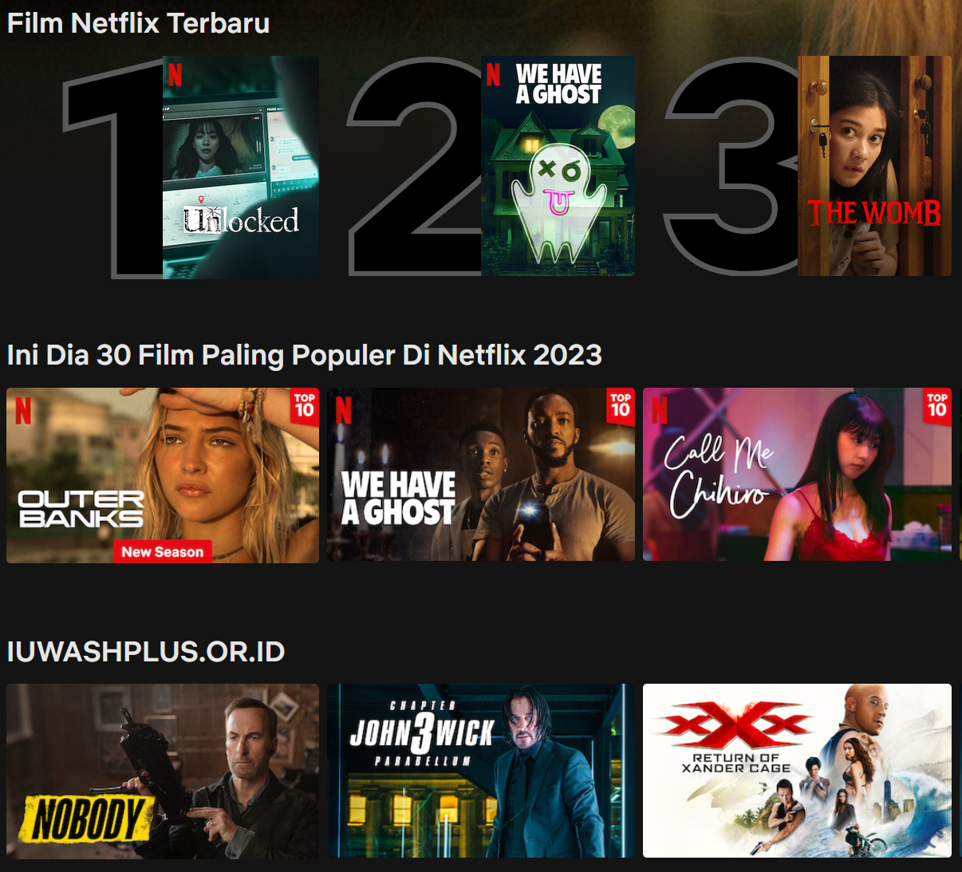

Introduction
Overview and Objectives
Tools: HTML, CSS, JavaScript
Planning
Research Netflix Website
Define Features and Create a Wireframe
Setup
Configure Development Environment
Organize Files and Folders
HTML Structure
Build Header: logo, navigation, search bar
Create Main Content: hero section, video carousel, movie list, about section
Design Footer: contact info, social links
AGENDA

Slide 4

CSS Styling
Global Styles
Style Header, Main Content, and Footer
Ensure Responsiveness with Media Queries
JavaScript Interactivity
Navigation Toggle
Video Carousel
Smooth Scrolling
Testing and Debugging
Cross Browser Setting
Device Compatibility Testing
Debugging issues
Deployment
Prepare for Deployment
Deploy the Website

Slide 5
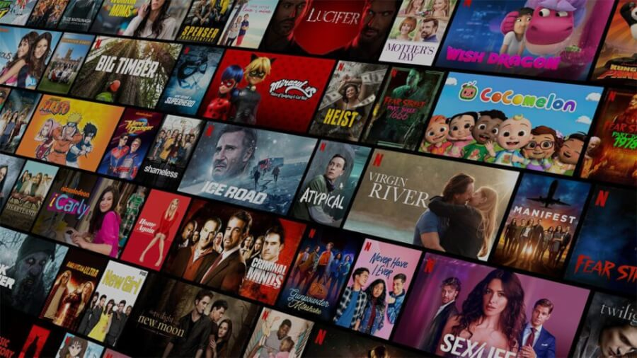
Purpose:
Create a Netflix clone website for a front-end development internship.
Scope:
Develop a responsive and interactive website using HTML, CSS, and JavaScript.
Objectives:
- Replicate the look and feel of the Netflix website.
- Implement core features such as navigation, video display, and interactive elements.
PROJECT OVERVIEW

Slide 6
Who are the End Users?
Target Audience:
- Movie and TV show enthusiasts.
- Regular Netflix subscribers.
- Potential Netflix users.
Characteristics:
- Users who value a visually appealing and user-friendly website.
- Individuals looking for information on Netflix's content library and services.
- Users interested in streaming high-quality video content.

Slide 7
Solution:
A cloned Netflix website that replicates the official site's design and functionality.
Value Proposition:
Provides a familiar interface for Netflix users.
Enhances user experience with responsive design and interactivity.
Serves as a learning and development tool for front-end skills.
Solution and Value Proposition

Slide 8
Customization and Uniqueness
Unique Aspects
Unique Aspects:
- Personalized design elements and themes.
- Custom interactive features like a video carousel and smooth scrolling.
Innovation and Creativity:
- Implementation of modern web design principles.
- Use of advanced CSS techniques and JavaScript functionalities.

Slide 9
---
Techniques and Methodologies:
Responsive Design:Use CSS Grid for complex layouts and Flexbox for simpler alignments.
JavaScript:For dynamic content updates and interactive features like search and modals.
Frameworks and Principles:
BEM: Structure CSS with Block, Element, and Modifier for better organization.
DRY: Avoid code repetition by creating reusable components and functions.
---
Modelling
Market y

Slide 10
Unique Aspects:
- Personalized Design Elements and Themes: Allow users to choose and customize themes for a personalized viewing experience.
- Custom Interactive Features: Include a product carousel for featured movies and smooth scrolling for seamless navigation.
Innovation and Creativity:
- Modern Web Design Principles: Apply cutting-edge design trends for a visually appealing and intuitive interface.
- Advanced CSS Techniques and JavaScript Functionality: Use animations, transitions, and AJAX for dynamic and engaging user interactions.
---

Slide 11


https://github.com/Khaviya-RT/IBM-INTERNSHIP-

